Slide 1
Employee performance analysis using excel
PRESENTED BY : VIGNESH G
REGISTER NO : 312204547
DEPARTMENT : COMMERCE (B.COM GENERAL)
COLLEGE : K.C.S. KASI NADAR COLLEGE OF ARTS AND SCIENCE

Slide 2
PROJECT TITTLE
EMPLOYEES ABSENTEEISSM ANALYSIS USING PIVOT TABLE

Slide 3
AGENDA
PROBLEM STATEMENT
PROJECT OVERVIEW
END USERS
OUR SOLUTION AND PROPOSITION
DATASET DESCRIPTION
MODELLING APPROACH
RESULTS AND DISCUSSION
CONCLUSION

Slide 4
PROBLEM STATEMENT
Absenteeism in the workplace can significantly impact productivity and operational efficiency.
To manage and address absenteeism effectively, it is essential to analyze patterns and trends related to employee absences.
To analyze employee absenteeism data to identify patterns, trends, and potential issues that could help in developing strategies for improving attendance and overall workforce management.

Slide 5
Project overview
Absenteeism in the workplace is a significant issue that can impact productivity, team morale, and overall organizational efficiency. Identifying the underlying causes and implementing effective strategies to manage and reduce absenteeism is crucial for maintaining a high-functioning and motivated workforce.

Slide 6
WHO ARE THE END USER
EMPLOYER
EMPLOYEE
ORGANISATION
BUSINESS PEOPLE

Slide 7
OUR SOLUTION AND ITS VALUE PROSITION
FILTERING – remove missing values
CONDITIONAL FORMATING – blanks
PIVOT TABLE – summary of the sales department wise
FORMULAS – IFS
GRAPHS – final report

Slide 8
DATA SET DESCRIPTION:
Employee ID- Unique identifier for each employee
DEPARTMENT - the department the employee belongs to.
SALARY - for confidentiality reasons, salary comes in three tiers: low, medium, high.
SATISFACTION - a measure of employee satisfaction from surveys.
AVG_HRS_MONTH- the average hours the employee worked in a month.

Slide 9
MODELLING :
DATA SET: Kaggle , Employee data set
DATA CLEANING: Missing values, Irrelevant
FORMULA: Performance calculation, low, med high.
PIVOT TABLE: summary, business units, gender, employment type, employee id, performance
CHART: Report: slicer

Slide 10
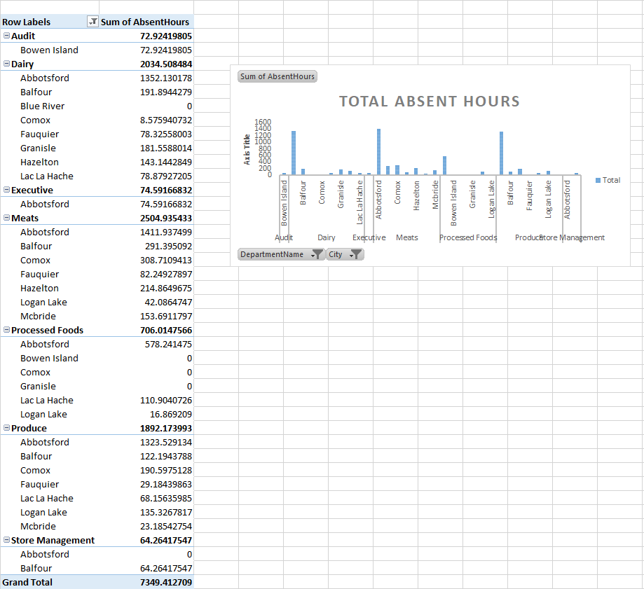
RESULT:
EMPLOYEES ABSENTEEISSM ANALYSIS USING PIVOT TABLE

Slide 11
CONCLUSION:
The analysis of employees' absent hours provides valuable insights into workforce dynamics and operational efficiency. Key takeaways include:
Absenteeism Trends:
Patterns Identified: The data reveals clear patterns in absenteeism, with certain departments or times of year experiencing higher rates of absence. For instance, absences may peak during specific months or correlate with particular events (e.g., flu season).
Frequency and Duration: High absenteeism rates in specific departments or among certain employees may indicate underlying issues such as job dissatisfaction, high stress levels, or workplace environment concerns.

